Slide 1
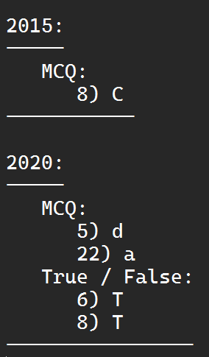
Migration Services {Final 2017}
Is the process of moving a VM from:
One Host server to another.
One Storage Location to another.
One Data center to another.
Where all key of VM’s components are completely virtualized.
MCQ – T F

Slide 2
{Final 2015 - 2017} |  | Cold Migration | Hot Migration | Warm Migration
Similarity |  | All are Methods for moving VMs from one physical machine to another.
Differences | Another Name | Regular | Live | Suspended / Paused
Differences | Host | Host is Powered Off | Host is Powered On | Host is Suspended
 | Shared Storage | VMs aren’t required to be on a shared storage | VMs are required to be on a shared storage | VMs aren’t required to be on a shared storage
 | CPU | Not apply CPU compatibility checks | Apply CPU compatibility checks | Not apply CPU compatibility checks
 | Process | Simple process | Less Simple Process | Less Simple Process

Slide 3
VM Migration Using Post-Copy Data Transfer {Final 2015}
Suspend The Migrating of VM at the source side.
Copy minimal subset of the execution state of the VM state to the target (Destination).
Resuming VM Migration.
Concurrently, the source actively pushes the remaining memory pages to the target.

Slide 4
Migration – Green ICT {Final 2017}
The relationship between Migration and Green ICT is that migration improves the energy efficiency by reducing power consumption.
Migration – SLA {Final 2017}
The relationship between Migration and SLA is that migration plays an important role in data centers by making it easy to adjust resources priorities to match resources demand conditions so, it’s completely going in the direction of meeting SLAs.

